Slide 1
Spam Detection with Mail
21se02ml009 :- Shemil Devani
21se02ml001 :- Zeel Aghera
21se02m026 :- Jay Mangukiya

Slide 2
What is spam?
Unsolicited email
Can be commercial or fraudulent
Can be a nuisance or a security threat
Why is spam detection important?
To reduce the amount of spam in your inbox
To protect your computer from malware
To protect your personal information

Slide 3
Spam detection technique
Spam detection techniques
Content-based filtering
Heuristic filtering
Blacklists and Whitelists
Bayesian filtering
Machine learning

Slide 4
Machine learning
Machine learning has revolutionized spam detection by providing more accurate and adaptive methods for identifying and filtering spam emails.
Traditional rule-based and heuristic approaches often struggled to keep up with the constantly evolving tactics used by spammers.
Machine learning, on the other hand, enables systems to learn patterns and characteristics from data, making it more effective in detecting and classifying spam emails.

Slide 5
Key feature of machine learning
Feature Extraction
Supervised Learning
Unsupervised Learning
Hybrid Approaches
Real-time Detection
Feature Selection and Engineering
Evolving Models
Evaluation Metrics

Slide 6
Feature extraction
Machine learning models require relevant features from emails to make predictions.
Common features include email content, sender information, subject line, attachments, and timestamps.
Feature extraction is a crucial step in preparing the data for training the model.

Slide 7
Supervised Learning
Supervised learning is one of the main techniques used in spam detection. It involves training a model on a labeled dataset, where each email is labeled as either spam or non-spam (ham).
Popular supervised learning algorithms for spam detection include:
  Naive Bayes Classifier
  Support Vector Machines (SVM)
  Decision Trees
  Random Forests
  Neural Networks

Slide 8
Unsupervised Learning
Unsupervised learning can be used to identify patterns and group similar emails without labeled data.
It is particularly useful for detecting new and emerging spam patterns that may not have been seen before.

Slide 9
Hybrid Approaches
Hybrid models combine both supervised and unsupervised learning techniques to achieve better spam detection results.
They can leverage the strengths of both approaches and overcome their individual limitations.

Slide 10
Real-time Detection
To ensure timely filtering, machine learning models can be optimized for real-time spam detection. This is critical in preventing spam from reaching users' inboxes promptly.

Slide 11
Feature Selection and Engineering
Choosing the right features and engineering them appropriately can significantly impact the performance of the spam detection model.
Feature selection helps in eliminating irrelevant or redundant features, while feature engineering may involve transforming or creating new features to improve model accuracy.

Slide 12
Evolving Models
Machine learning allows spam detection systems to continuously learn and adapt to new spamming techniques.
As spammers change their strategies, the model can update itself to stay effective.

Slide 13
Evaluation Metrics
To assess the performance of a spam detection model, various evaluation metrics are used, such as accuracy, precision, recall, F1 score, and ROC-AUC.

Slide 14
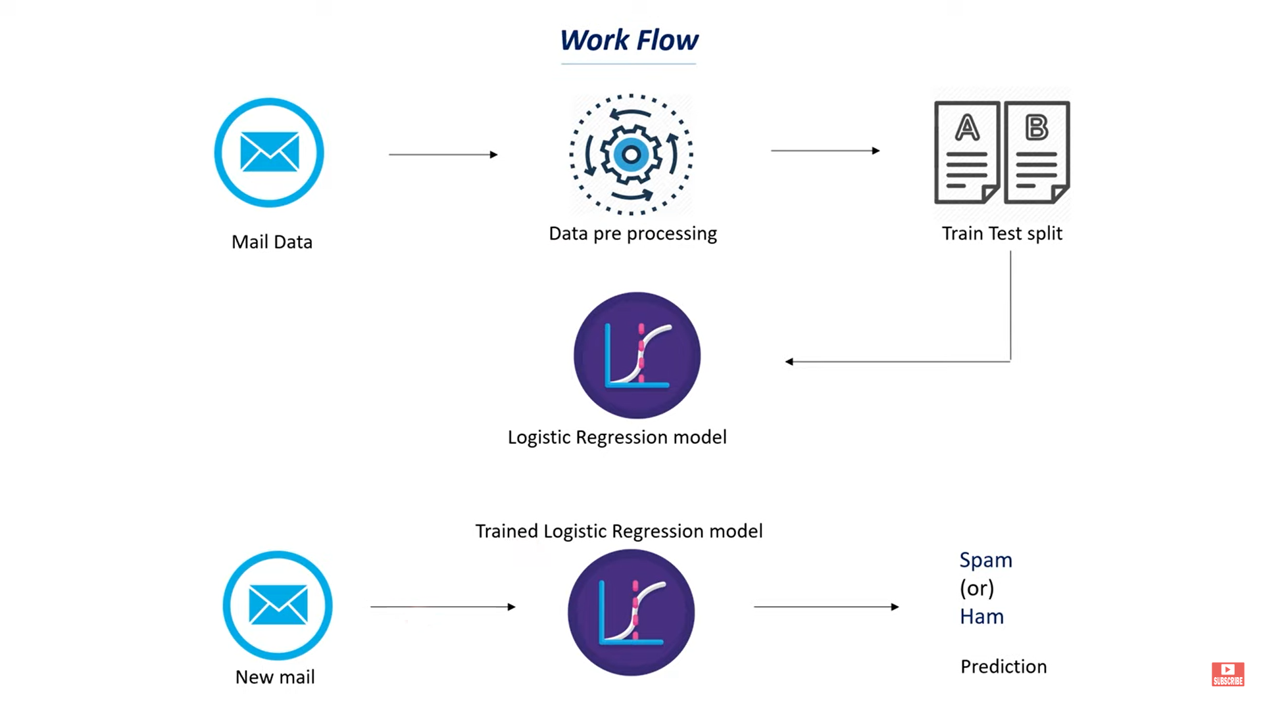
System model

Slide 15
conclusion
In conclusion, spam detection with email is an ever-evolving field that continues to benefit from the advancements in machine learning and artificial intelligence.
By working together with user feedback, industry collaboration, and cutting-edge technologies, we can strive to create a safer and more enjoyable email experience for all users.
In the future, we can expect even more sophisticated machine learning models, combined with other technologies like natural language processing and deep learning, to further enhance spam detection accuracy and efficiency.
Moreover, user education and awareness about email security and phishing threats will remain crucial in complementing the efforts of spam detection systems.

Slide 16


